Slide 1

Mitron Bank Challenge
Provide Insights to the Product Strategy Team in the Banking Domain presented by Codebasics
github.com/Ankan2508
Presented By : Ankan Bandyopadhyay

Slide 2

Problem Statement
Mitron Bank is a legacy financial institution headquartered in Hyderabad. They want to introduce a new line of credit cards, aiming to broaden its product offerings and reach in the financial market.
To analyse the provided sample data and report key findings to the strategy team of Mitron Bank. This analysis is expected to guide them in tailoring the credit cards to customer needs and market trends.

Slide 3
Goals
Task: Imagine yourself as Peter Pandey and perform the following tasks
Goals 1
Goals 2
Goals 3
Goals 4
Use “Insight Ideas from Tony.pdf”. Create metrics and visuals accordingly.
Design a dashboard with your metrics and analysis. The end users of this dashboard are top-level management and the product strategy team hence the dashboard should be self-explanatory and easy to understand.
Present your insights to Mr.Bashnir Rover & team. Be creative and concise with your presentation. Use your dashboard in the presentation along with the deck.
Use additional data based on your own research to support your
recommendations.

Slide 4

Data at a Glance
The dataset was provided with data of 4000 customers. The dataset had two CSV files.
dim_customers
fact_spends
View More

Slide 5
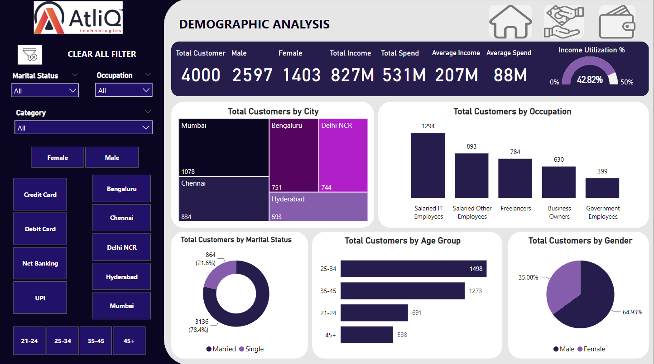
Analysis
View More

Slide 6
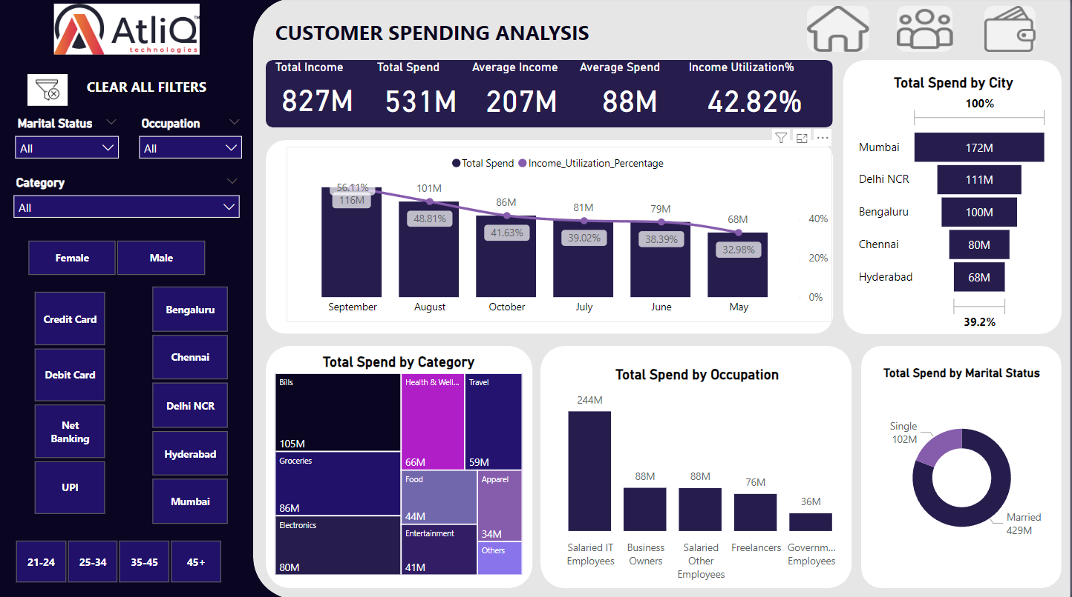
Analysis
View More

Slide 7
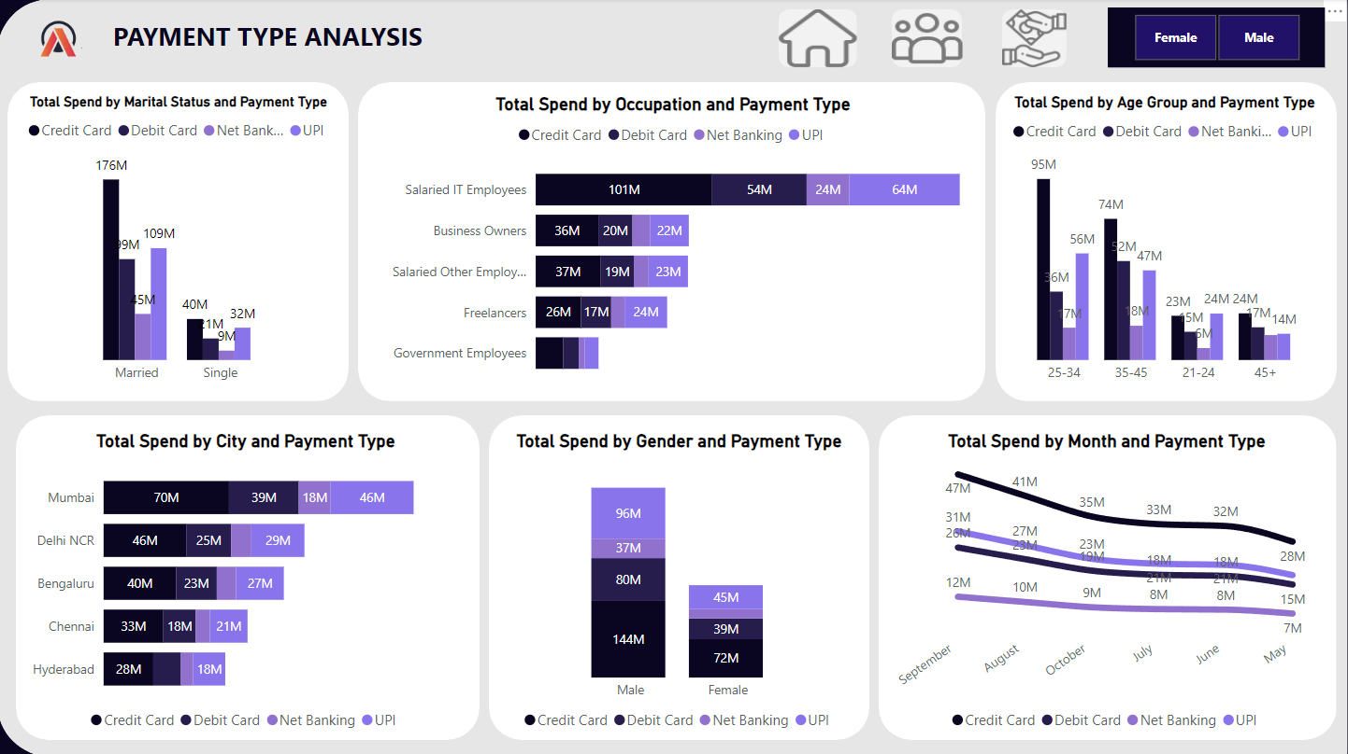
Analysis
View More

Slide 8
Insights
Some snippets from the Dashboard
Demographic Analysis:
Total Customers: 4000 | Total Male: 2597 | Total Female: 1403
Most Customers are based in Mumbai (1078)
Most Customers are Salaried IT Employees (1294)
Married: 3136 (78%) | Single: 864 (22%)
Most Customers are in the Age group of 25-34: 1498 | 35-45: 1273
Income Utilization % : 42.82%
Credit Card Spending Analysis:
Male: 144M | Female: 72M
Married: 176M | Single: 40M
Most spending done in Mumbai (70M)
Most spending done in the month of September (47M)
Most spending is done by Salaried IT Employees (101M)
Most spending is done in the age group of 25-34: 95M
Customer Spending Analysis:
Married: 429M | Single: 102M
Most spending done in Mumbai (172M)
Most spending done in the month of September (116M)
Most spending is done for Bills Payment (105M)

Slide 9
Solution or Strategy
Tailored Rewards Program:
Create a rewards program that specifically caters to the preferences and spending patterns of the different demographic segments.
For example, offer exclusive benefits for married customers, single customers, or those in the 25-34 age group.
City-Specific Offers:
Introduce city-specific promotions and discounts based on the highest spending cities like Mumbai, Delhi NCR, and Bengaluru.
Collaborate with local businesses to provide unique perks for cardholders in these cities.
Occupation-Centric Features:
Design credit card features that align with the needs of the majority occupation group, such as special benefits for Salaried IT employees.
Offer targeted promotions and discounts on relevant services and products for each occupation category.

Slide 10
Solution or Strategy
Monthly Spending Challenges:
Encourage cardholders to maximize their credit card usage by creating monthly spending challenges.
Offer bonus rewards or cashback for achieving specific spending milestones, especially during peak spending months like September.
Customized Credit Limits:
Implement a dynamic credit limit system that adjusts based on the income utilization percentage (IU%) and credit card usage percentage (CC%).
This ensures responsible credit card usage while providing flexibility to customers.
Gender-Specific Benefits:
Introduce gender-specific benefits and promotions to attract and retain customers from both genders.
For example, exclusive deals on fashion, wellness, or entertainment based on gender preferences.

Slide 11
Solution or Strategy
Mobile App Features:
Enhance the mobile app with personalized spending insights, budgeting tools, and real-time notifications.
Provide actionable suggestions to users based on their spending behavior.
Seasonal Spending Campaigns:
Launch seasonal campaigns that align with the highest spending months (e.g., September and August).
Offer additional rewards or cashback for specific categories during these periods.
Collaborations with Top Spenders:
Partner with top spenders in various categories (bill payments, groceries, electronics) to provide exclusive discounts or early access to new products and services.
Credit Card Upgrade Program:
Create a credit card upgrade program based on customer spending and credit card usage.
Offer premium benefits, increased rewards, or lower interest rates for customers who consistently demonstrate responsible card usage.

Slide 12





Presented by
Ankan Bandyopadhyay
ankan.ab21@gmail.com
Howrah, West Bengal, India
+91 9831238661
github.com/Ankan2508
www.linkedin.com/in/bandyopadhyay-ankan

